Slide 1
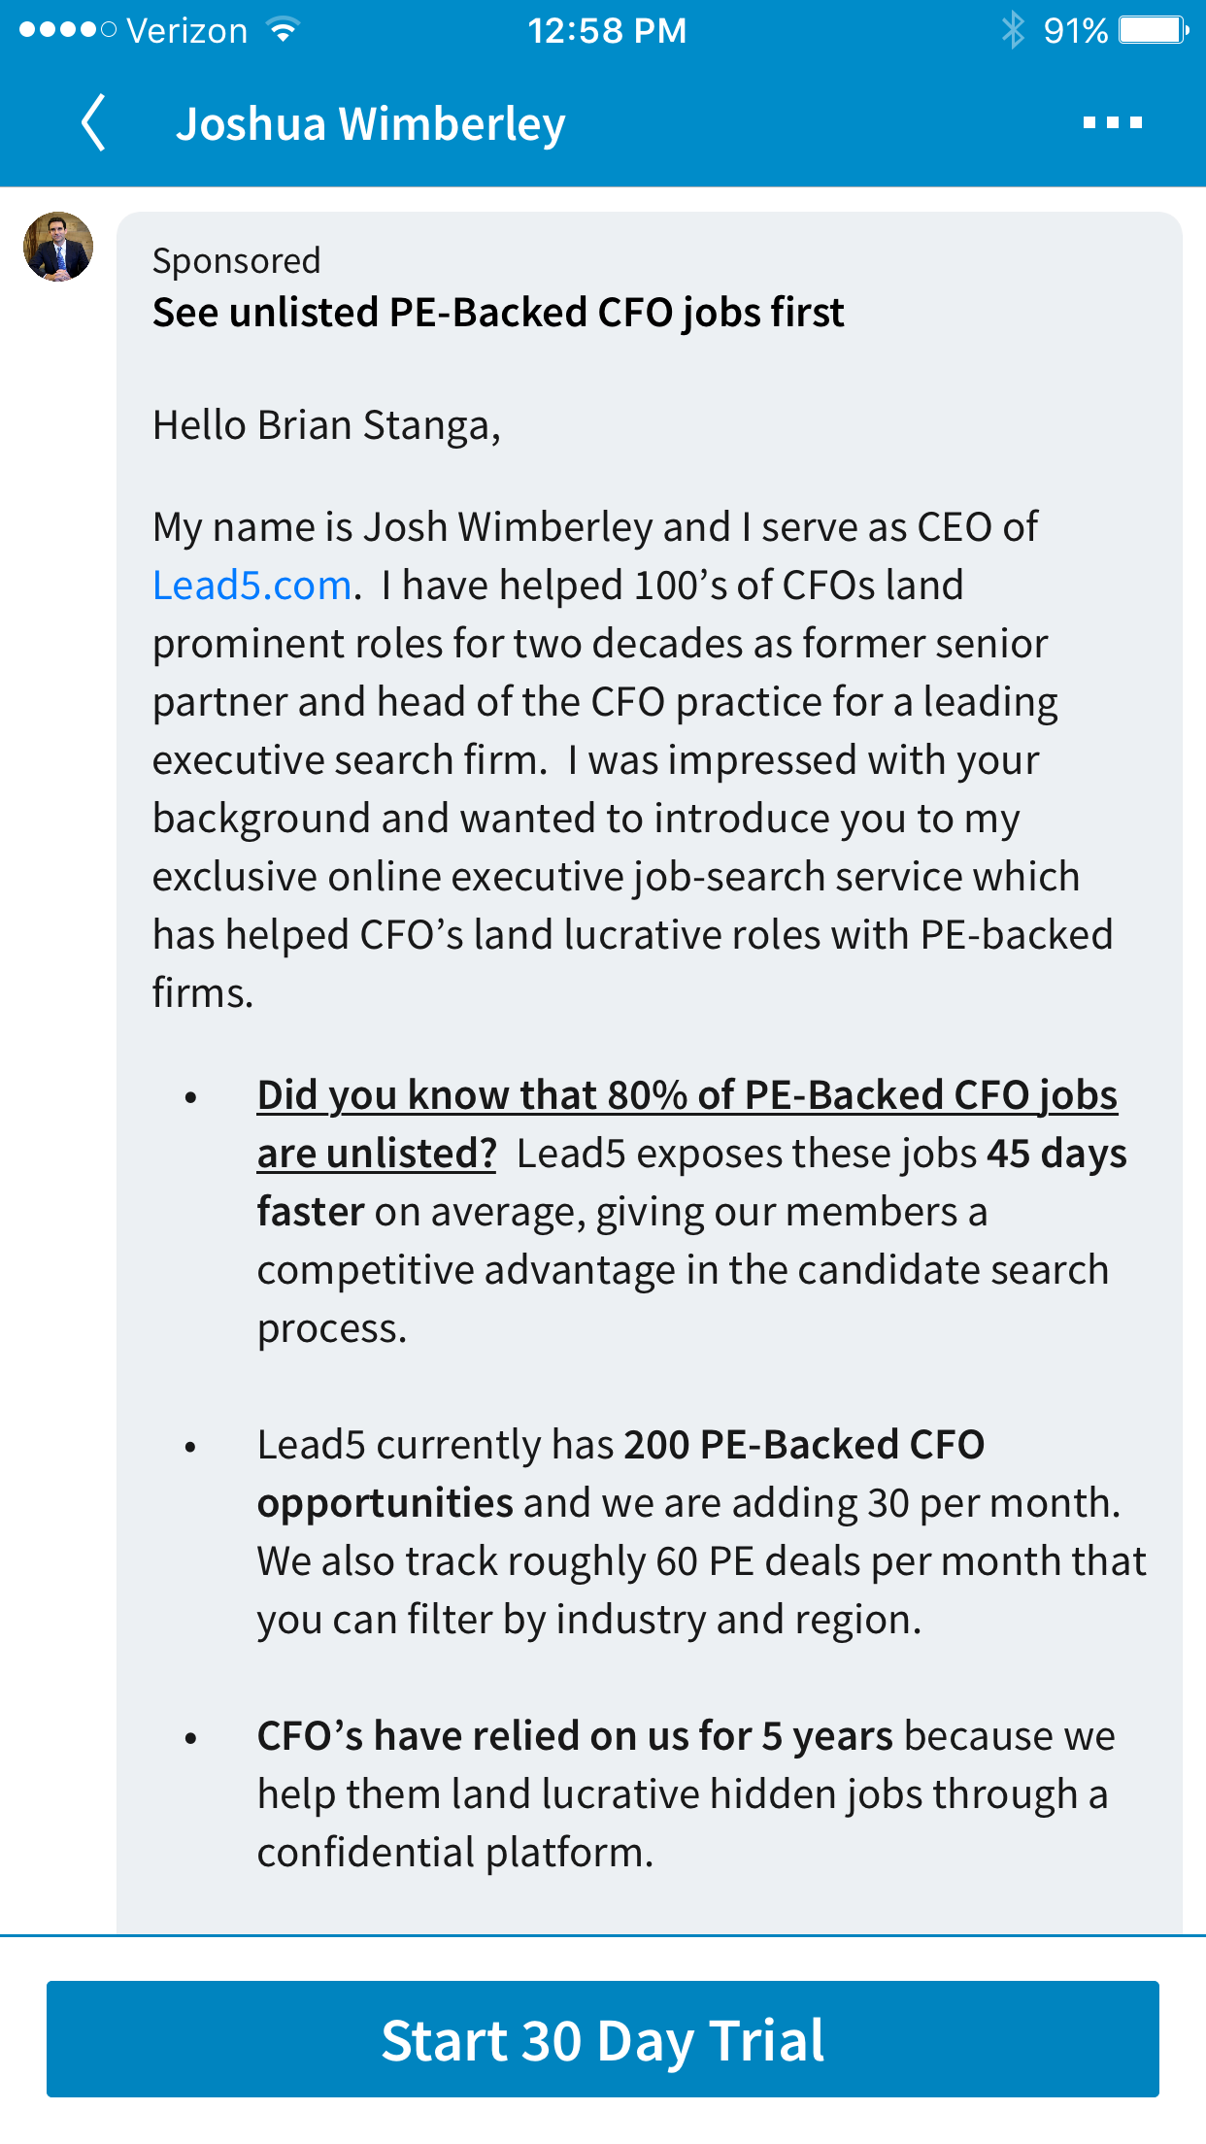
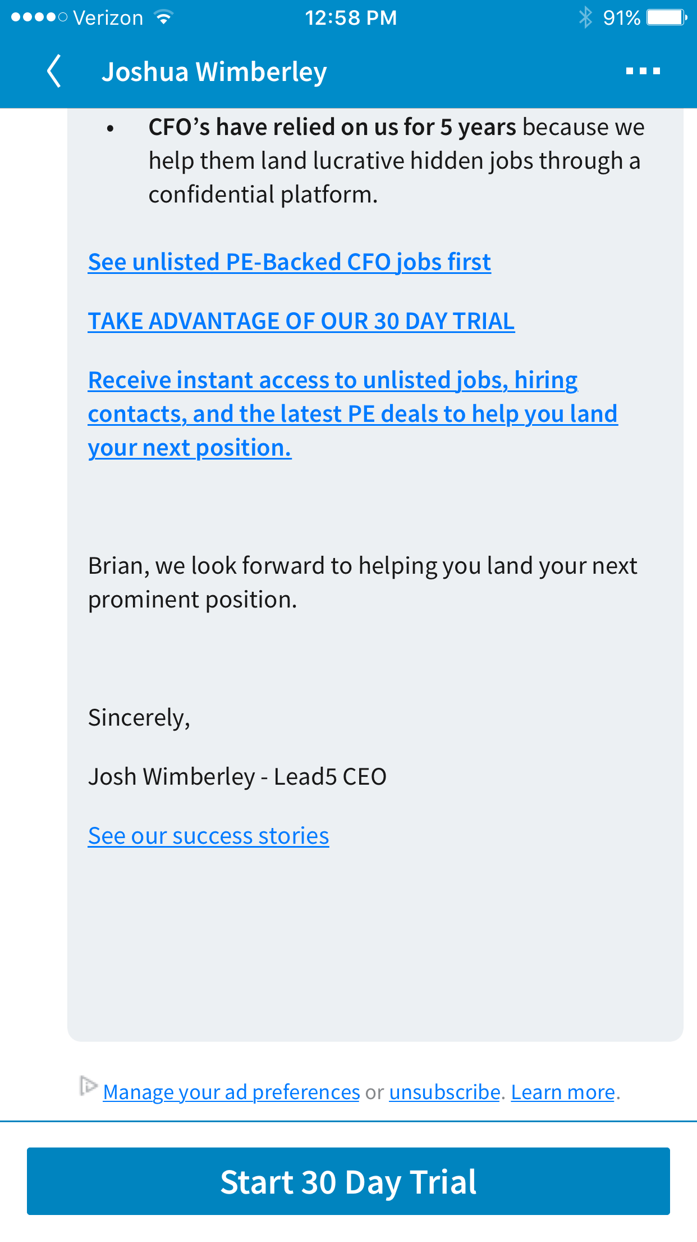
In-Mail Top Fold
In-Mail Bottom Fold

Slide 2
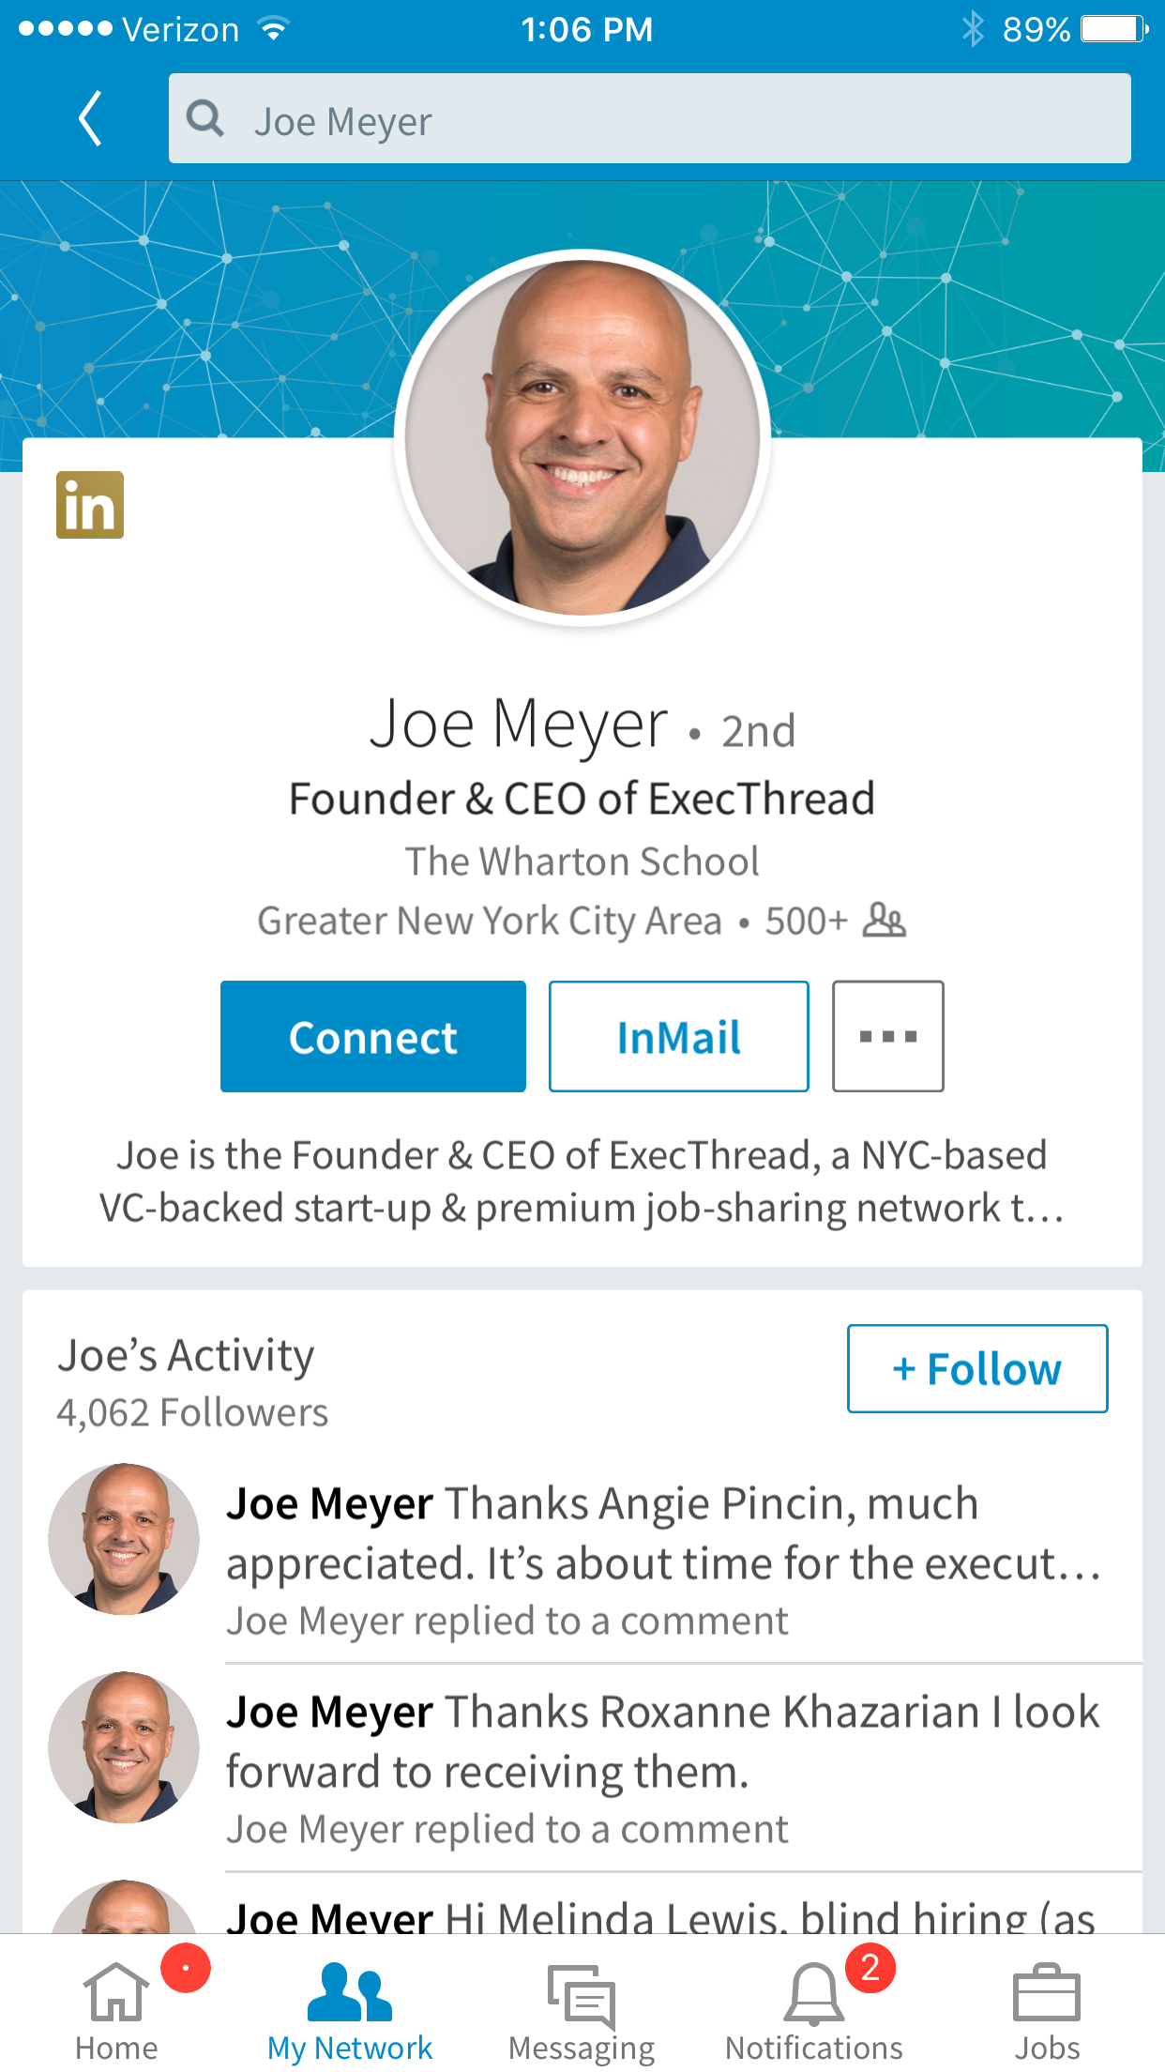
In-Mail Top Fold
In-Mail Bottom Fold
This description is mainly about Joe, doesn’t articulate ET value prop…or why Joe is could be valuable to me.

Slide 3
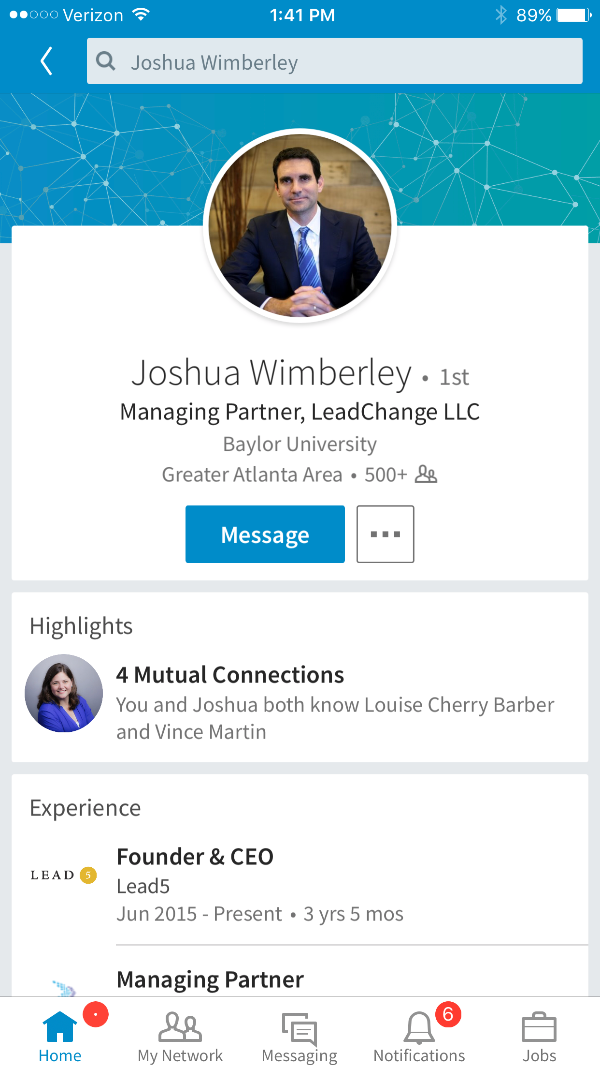
Use Case: Recipient receives an acquisition in-mail from JW
Brighten
Change LeadChange to Lead5; Keep leadchange, add Lead5 CEO and founder
A. “Josh is the Lead5 CEO and his passion is helping top execs tap the 80% unlisted job market.”
Reaction: “Josh has a passion/mission and this lines up with what I’m after.”
B. “Josh is the Lead5 CEO and his mission is helping top execs tap the 80% unlisted job market.”
Josh is passionate about helping top execs land prominent roles
3 years 5 mos conflicts with ‘5 year’ claim of Lead5
Let’s lock-down a company profile

